Slide 1
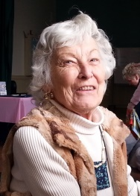
Tunisian Crochet Tutorial
Helen Carr
Instructor

